Slide 1

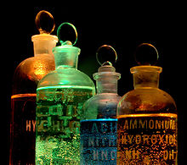

CHEM 105
Sections 31-49
When the road gets difficult, remember why you’re travelling on it.
Enter to Learn, Go Forth to Serve
Dr. Stacey J. Smith
Fall 2024
Notes:
When the road gets difficult, remember why you’re travelling on it.

Slide 2
Lecture 12:
4.1, 4.2, 4.6, 4.9, 5.3
Bonding
4.1 Chemical Bonds and Greenhouse Gases
4.2 Electronegativity, Unequal Sharing, & Polar Bonds
4.3 Naming Compounds and Writing Formulas
4.4 Lewis Symbols and Lewis Structures
4.5 Resonance
4.6 The Lengths and Strengths of Covalent Bonds
4.7 Formal Charge: Choosing among Lewis Structures
4.8 Exceptions to the Octet Rule
4.9 Vibrating Bonds and the Greenhouse Effect
5.3 Polar Bonds and Polar Molecules
Notes:
Have 20 min to get through first 11 slides and finish electronegativity. Then 10 min for ionic bonds, and 20 min for covalent bonds
Learning Objectives:
Understand types of bonding
Understand lattice energy of ionic compounds & predict trends in the lattice energy
Understand polar bonds, dipole moments, & requirements for polar molecules
Name ionic compounds
Name acids
Name covalent compounds

Slide 3
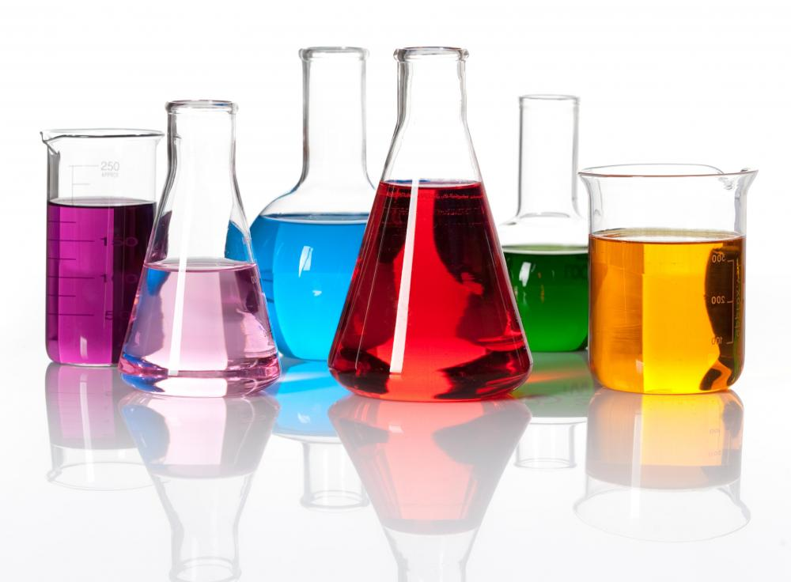
Chemistry
The study of matter –
its composition, structure, properties, & the changes it undergoes (along with the energy involved)
Outline of Chem 105:
  Composition of Matter → Atoms: Chapters 1-3
  Structure of Matter → Molecules: Chapters 4-5 (18,19)
  Properties of Matter → Phases, Gases: Chapters 6,9
  Changes → Chemical Reactions & the energy involved: Chapters 7,10,12
Notes:
In our study of matter – its composition structure properties & the changes it undergoes with the energy involved – we are a little more than 1 quarter of the way through.
We’ve just spent a few weeks studying the composition of matter – ATOMs!
We’ve learned
why we think matter is composed of atoms,
what atoms are,
and what makes the atoms of 1 element different from another

Slide 4


Structure
Structure of matter = how atoms are arranged spatially
Example: Ethanol and dimethyl ether have the same composition – same # and types of atoms (C₂H₆O) – but have different structures.
CH₃-CH₂-OH
CH₃-O-CH₃
Ethanol is a liquid at room T
Dimethyl ether is a gas
Why the difference?
Bonds!

Slide 5
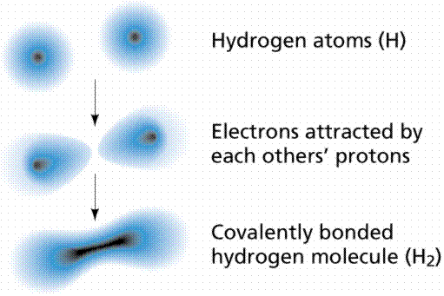
Bonding
Chemical bond = electrostatic attraction holding two atoms close together
  Bonds aren’t sticks!
  Bonds are simply electrostatic attraction
    2 nuclei attracted to the e- around them
Why do bonds form?
1s
1s

Slide 6
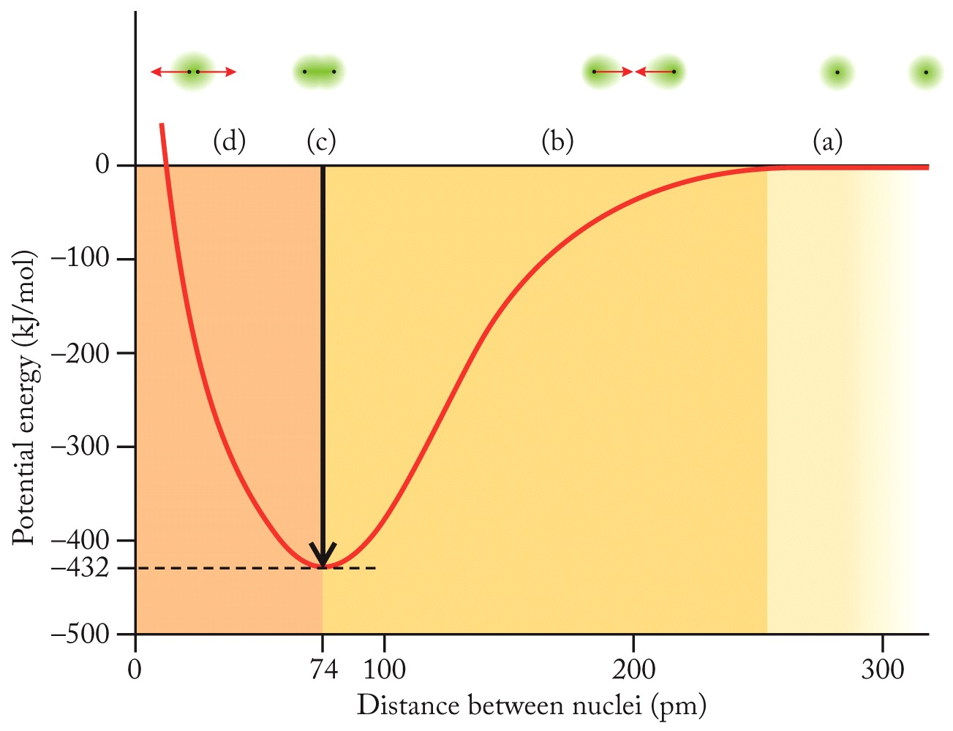
Energy as two H Atoms Come Together
Minimize energy
Lower energy state = more stable
Two H atoms sharing electrons is more stable than two separate H
Notes:
Short answer is to minimize energy.
This is diagram shows what happens to the energy states of 2 H atoms as they approach one another.
Long distance = no interaction
As they get closer, they start to interact – the e- now have 2 positive nuclei to be attacted to, so their energy state goes down.
If the two nuclei get too close together, the + charge starts to repel, but at a certain distance there’s a sweet spot – an energy minimum.
Lower energy state = more stable
Two H atoms sharing electrons is more stable than two separate H. Which is why H2 is the elemental form of hydrogen.
But some atoms are better at sharing than others…

Slide 7

iClicker Quiz
Which is the most accurate description of a chemical bond?
A spring between two atoms
A stick between two atoms
A linking of atoms with their hooks
Electrostatic attraction
Electrostatic attraction providing an energy advantage for atoms to remain near one another

Slide 8
iClicker Quiz
What is always true about breaking a chemical bond?
Energy is released
Energy is required

Slide 9
Energy as two H Atoms Come Together
Minimize energy
Lower energy state = more stable
Two H atoms sharing electrons is more stable than two separate H
Some atoms share better than others…
Notes:
Short answer is to minimize energy.
This is diagram shows what happens to the energy states of 2 H atoms as they approach one another.
Long distance = no interaction
As they get closer, they start to interact – the e- now have 2 positive nuclei to be attacted to, so their energy state goes down.
If the two nuclei get too close together, the + charge starts to repel, but at a certain distance there’s a sweet spot – an energy minimum.
Lower energy state = more stable
Two H atoms sharing electrons is more stable than two separate H. Which is why H2 is the elemental form of hydrogen.
But some atoms are better at sharing than others…

Slide 10


2 extremes of bonding
Ionic: ~complete transfer of 1 or more electrons from one atom to another (bond is attraction of ions)
Covalent: valence electrons shared ~equally between atoms
Most bonds are somewhere in between.
Notes:
0:15

Slide 11
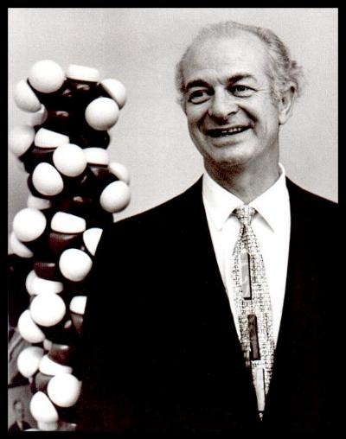
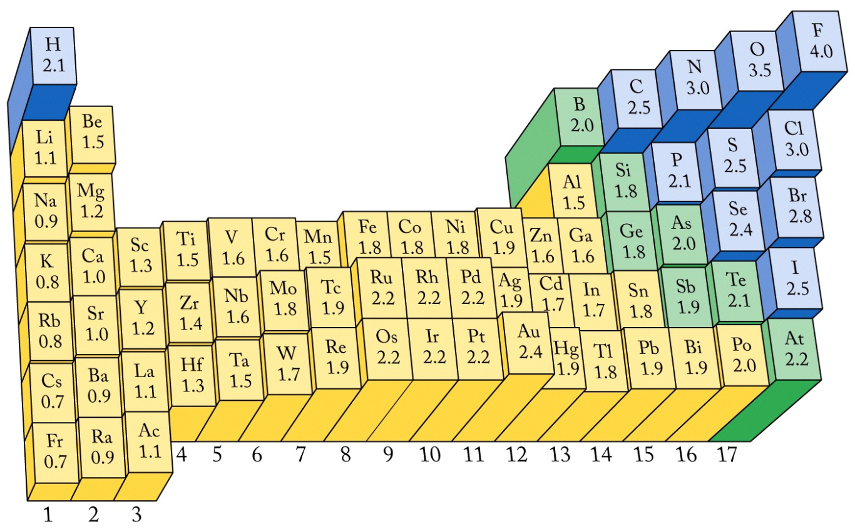


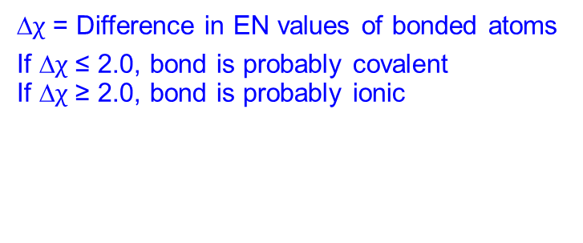
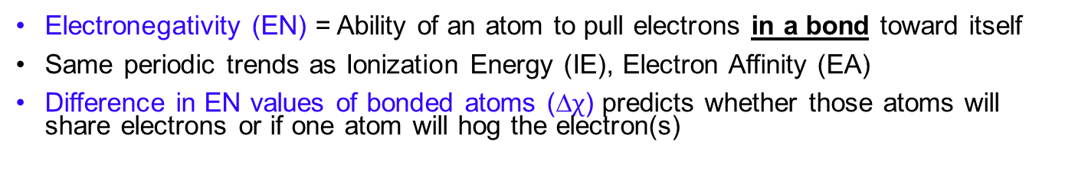
Electronegativity
Electronegativity (EN) = Ability of an atom to pull electrons in a bond toward itself
Same periodic trends as Ionization Energy (IE), Electron Affinity (EA)
Difference in EN values of bonded atoms (∆$χ$) predicts whether those atoms will share electrons or if one atom will hog the electron(s)
∆$χ$ = Difference in EN values of bonded atoms
If ∆$χ$ ≤ 2.0, bond is probably covalent
If ∆$χ$ ≥ 2.0, bond is probably ionic
Linus Pauling
(1901 - 1994)
American Chemist/Biochemist
2 Nobel Prizes:
Chemistry (1954)
Peace (1962)
Pauling Electronegativity
Scale
Notes:
Man named Linus Pauling came up with a way to measure how much a particular atom is likely to NOT share electrons (how likely an atom is to HOG the bonding electrons), and he called it electronegativity, which is…
He came up with a quantitative scale of electronegativity based on dissociation energies
Mulliken came up with a definition of electronegativity that is the average between first ionization energy (how much energy it takes to rip an electron away from an atom) and electron affinity (energy change involved when you try to add 1 electron to an atom). But since electron affinity values are not known for all elements, the Pauling scale is still used (& because it’s what everyone is used to)
The whole reason we have individual numbers for each element is so that we can compare them – take the difference between them

Slide 12
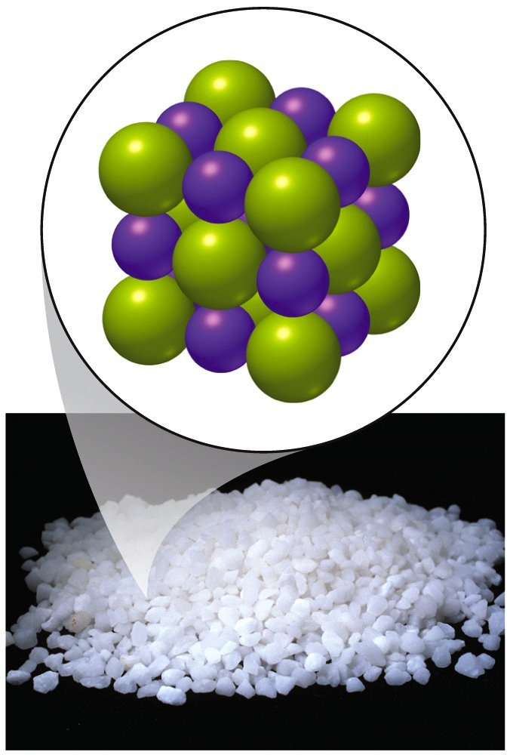
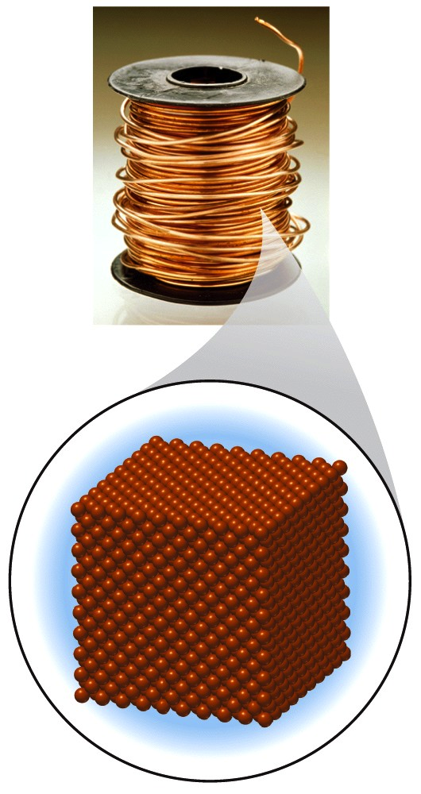
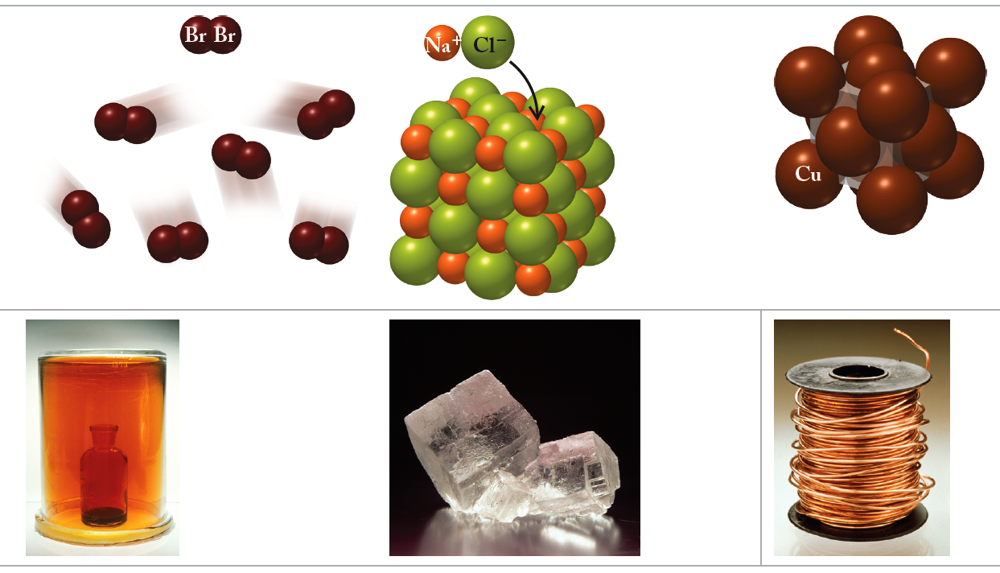
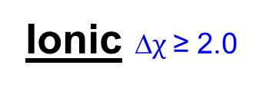
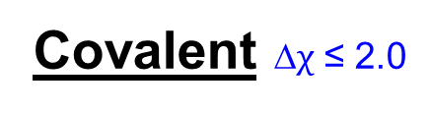
Chemical Bonds
Ionic ∆$χ$ ≥ 2.0
Metallic
Covalent ∆$χ$ ≤ 2.0
  Transfer of electrons
  Bond = electrostatic attraction between ions
Metals with Nonmetals
Metals
Metal atoms sharing a sea of electrons
Sharing of electrons
in molecules
2 Nonmetals
(or metalloids)
Cu
KCl
Br₂
Notes:
0:20

Slide 13
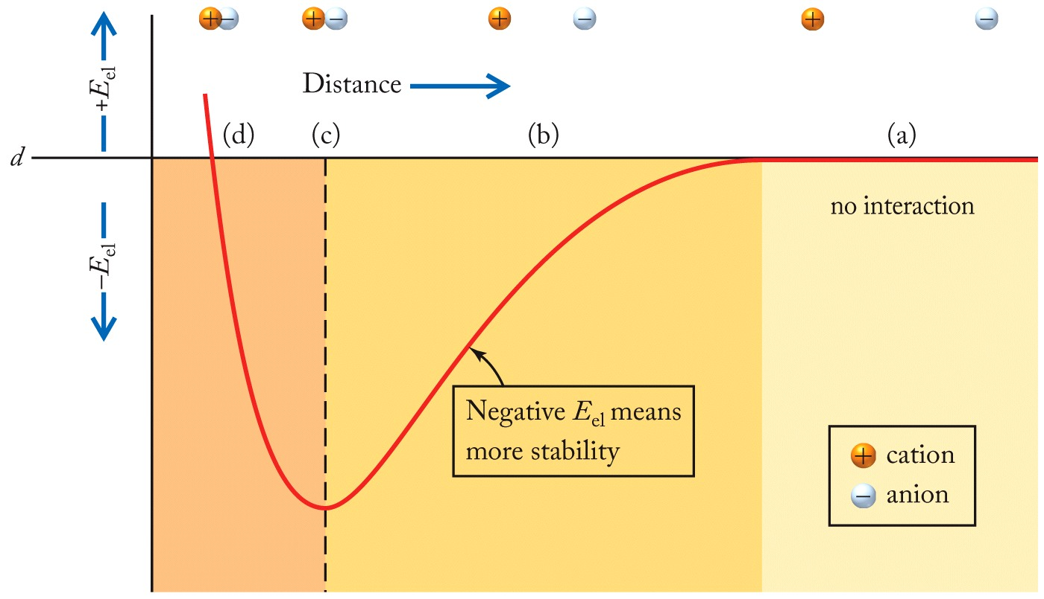
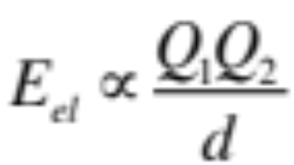
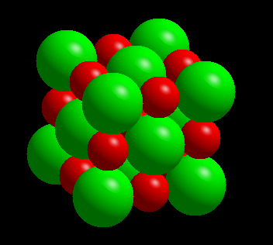
Ionic Bonds
FOR THOSE ATOMS WHO DON’T LIKE TO SHARE
CATION + ANION ⟶ SALT
metal + nonmetal ⟶ SALT
Crystal Lattice
Na⁺ + Cl– g NaCl
Notes:
Eel = electrostatic potential energy

Slide 14
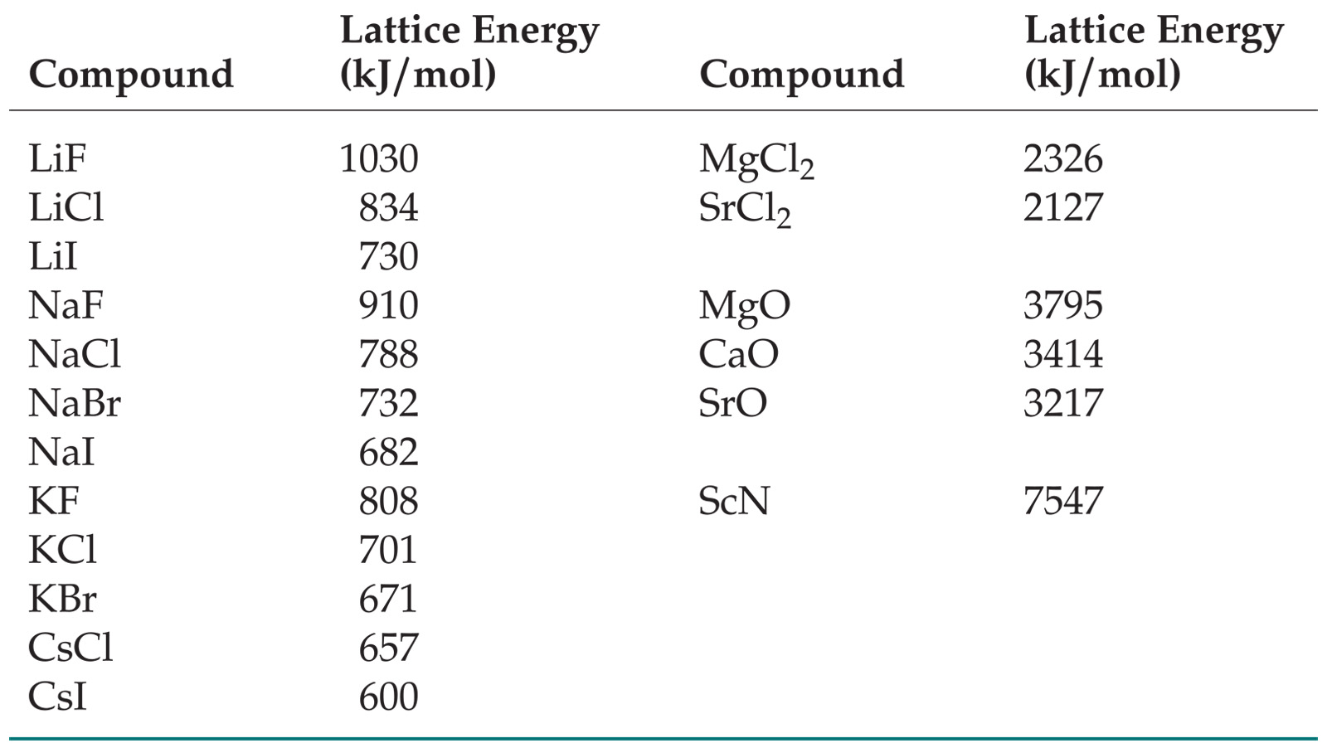
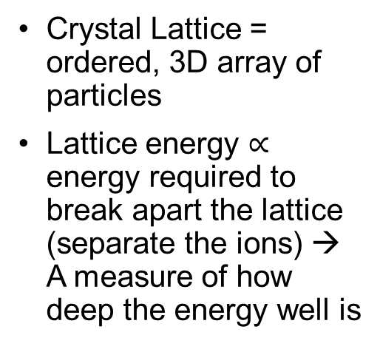
Lattice Energy
Crystal Lattice = ordered, 3D array of particles
Lattice energy $∝$ energy required to break apart the lattice (separate the ions) → A measure of how deep the energy well is
Crystal Lattice
What is the trend in lattice energy going down a group?
  Decreases due to increasing ionic radius (greater d)
Why the difference between Group 1 and Group 2?
  More charge (Q) = more attraction
Notes:
Crystal Lattice = ordered, 3D array of particles
Lattice energy = energy released when gas phase ions combine to form 1 mole of a crystalline solid
But that’s kind of a weird definition – for now just remember that it’s proportional to the energy required to break apart the lattice

Slide 15
iClicker Quiz
Which will have the greatest lattice energy?
KBr
NaCl
LiF
MgO
SrO
Notes:
Finish by 0:30

Slide 16
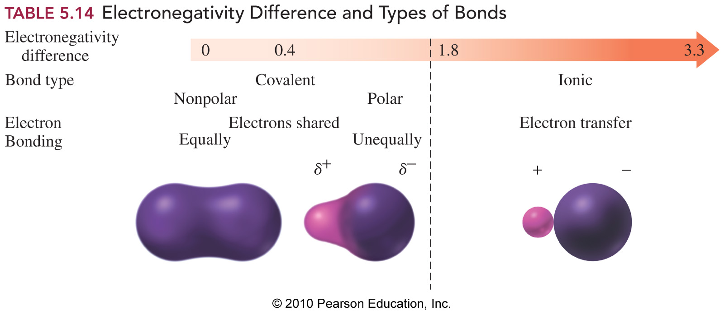

Covalent bonds
Some Share better than others…
Covalent bond = e- are shared between 2 nuclei
  0 < ∆χ < 0.4 = nonpolar covalent
  0.4 < ∆χ < 2.0 = polar covalent
Not strict rules!
∆$χ$
2.0
Notes:
Start at 0:30

Slide 17
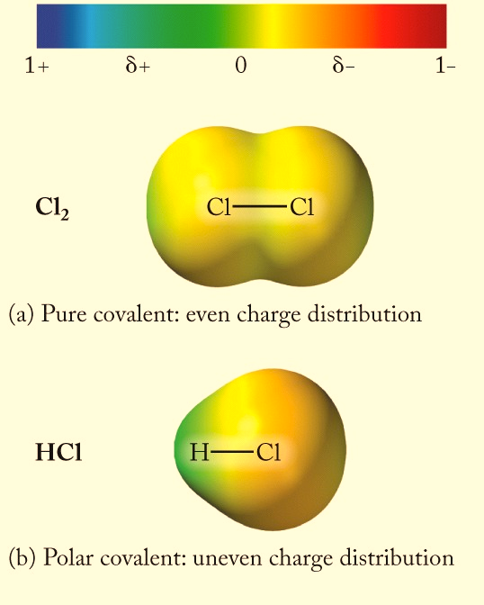
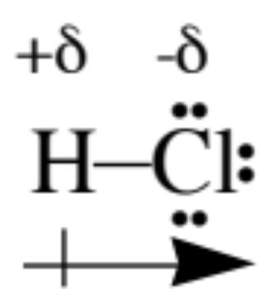
Polar bonds
Electrons are not equally shared in HCl
HCl bond has a + end and a – end. It is POLAR
HCl bond has a bond dipole & a dipole moment
Cl has a greater share of bonding e- than H.

Slide 18
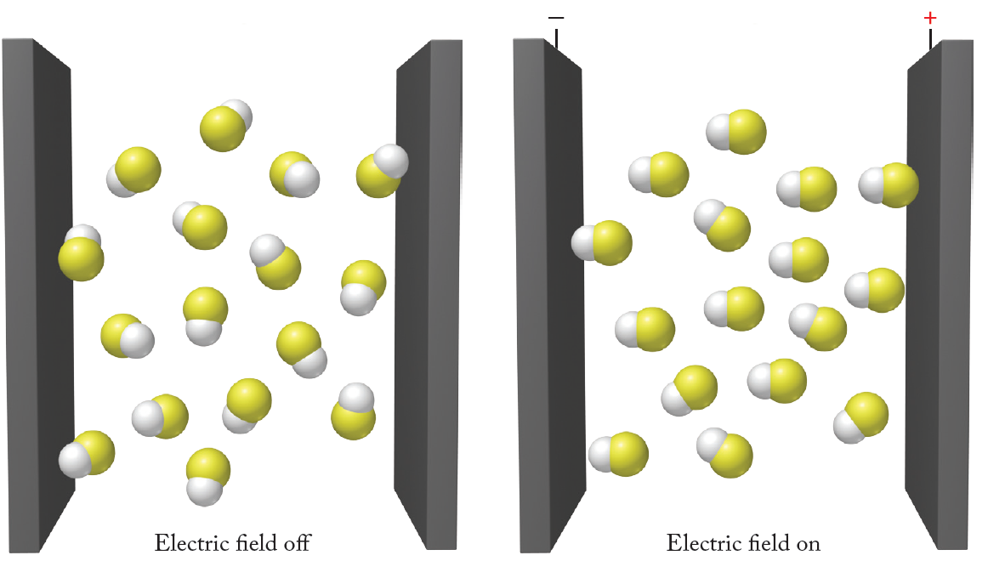
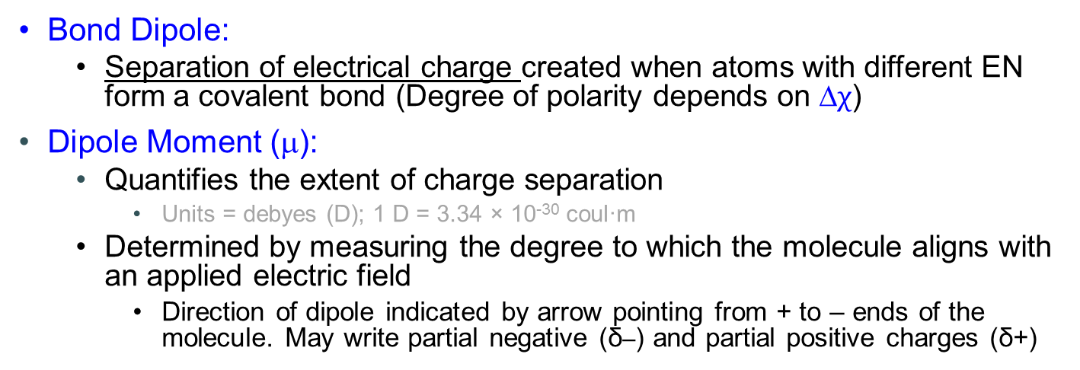
Dipole Moment
Bond Dipole:
  Separation of electrical charge created when atoms with different EN form a covalent bond (Degree of polarity depends on ∆$χ$)
Dipole Moment (μ):
  Quantifies the extent of charge separation
    Units = debyes (D); 1 D = 3.34 × 10⁻³⁰ coul·m
  Determined by measuring the degree to which the molecule aligns with an applied electric field
    Direction of dipole indicated by arrow pointing from + to – ends of the molecule. May write partial negative (δ–) and partial positive charges (δ+)

Slide 19
iClicker Quiz
Which of the following bonds in each pair are more polar?
A or B
C–S or C–O
N–H or C–H
Cl–Cl or O=O
Pauling Electronegativity
Scale
Notes:
Start at 0:35

Slide 20
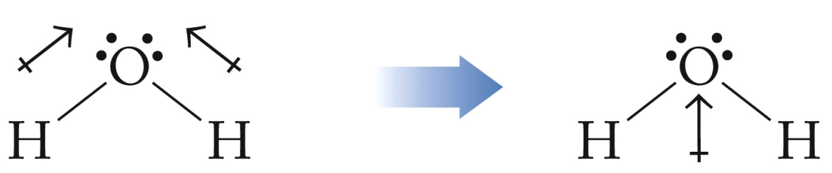
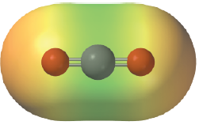

Polar Molecules
Polar Molecule:
  Whole molecule has a net dipole moment (not just 1 bond)
Requirement for Polar Molecule: asymmetric distribution of charge
  More negative charge exists over some part of the molecule than another part. Examples:
  Molecule has at least 1 polar bond & dipoles don’t cancel
  Lone pairs & polar bonds distributed asymmetrically in a molecule
H₂O = polar
CO₂ = nonpolar
Notes:
Start at 0:40
Now, according to both of these criteria, CO2 should be nonpolar. And it is – except when it’s not…
We have to remember that bonds aren’t sticks, and atoms are constantly moving (they only stop moving when T = 0 K)

Slide 21
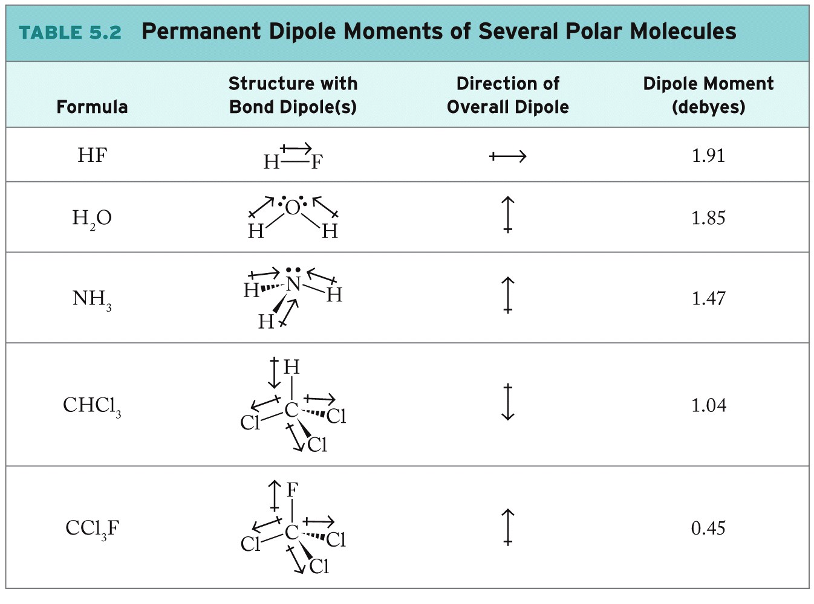
21

Slide 22
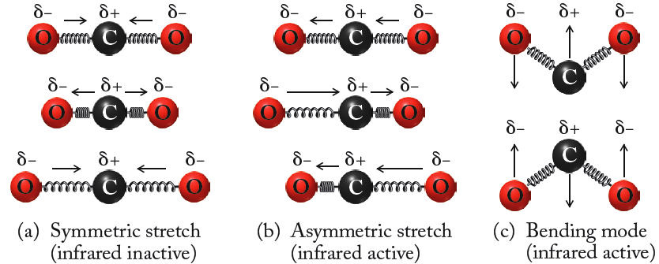
Vibration Modes
Absorption of energy by MOLECULES:
  Absorb infrared radiation if frequency matches frequency of vibration of IR active modes (‘excites’ them)
  → Basis of “greenhouse effect”
Notes:
We have to remember that bonds aren’t sticks, and atoms are constantly moving (they only stop moving when T = 0 K). And depending on how the atoms move or on how the bonds VIBRATE,
As these vibrations are excited, extra energy is dissipated through collisions with nearby molecules → HEAT

Slide 23
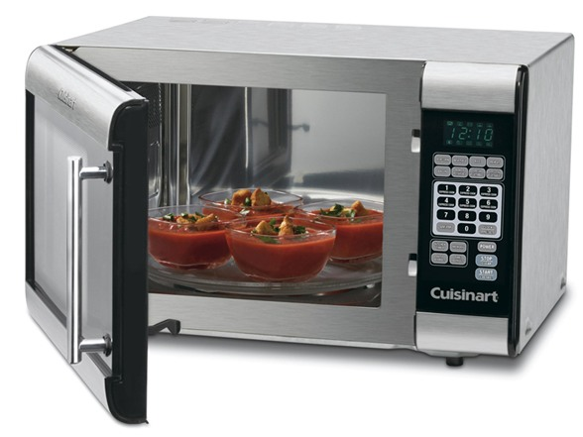
Your Microwave:
How does it work?
Polar Molecules!
Molecules with a dipole moment (H₂O) rotate as they align themselves with the oscillating electric field of microwave light
Rotating molecules hit other molecules, sending them into motion
Absorbed microwave energy is thus converted to kinetic energy of the molecules → HEAT!
Notes:
Water, fat, and other substances in the food absorb energy from the microwaves in a process called dielectric heating. Many molecules (such as those of water) are electric dipoles, meaning that they have a partial positive charge at one end and a partial negative charge at the other, and therefore rotate as they try to align themselves with the alternating electric field of the microwaves. Rotating molecules hit other molecules and put them into motion, thus dispersing energy. This energy, when dispersed as molecular vibration in solids and liquids (i.e. as both potential energy and kinetic energy of atoms), is heat.
Rotating molecules push, pull, and collide with other molecules (through electrical forces), distributing the energy to adjacent molecules and atoms in the material.
Rotating molecules push, pull, and collide with other molecules, distributing the energy to adjacent molecules and atoms in the material → HEAT!

